Slide 1
Telecommunications
Public Meeting
14 November 16

Slide 2
Agenda
Background and context
Priorities and negotiation process
Telecoms Licence - key points
--- Interlude for Q&A ---
Overview of new Communications Bill
Towards more effective regulation
The future

Slide 3
Navigation
Communications Bill
Provides framework for regulation of whole sector
Recognises public assets
Technology neutral
Defines ‘proactive’ regulator
Data retention, disclosure, privacy
Provision for Telecoms Appeal Panel
Sure’s Operating Licence
Exclusive in some areas (defined fixed/mobile telecoms services)
Non-exclusive in others
12 years with 2 year notice period
Service improvements, obligations, performance and fines
New price cap
Detailed role of regulator

Slide 4
The process began in 2014
August 2014: Commissioned Strategic Review of Telecoms
  Included engagement with public and business community
Spring 2014: Survey of Business and Residential Consumers
February 2015: Cartesian report draft findings
March 2015: Final reports from Cartesian
  Part A: Landscape and priorities (published)
  Part B: Strategic options analysis and commercial approach (not published)
April 2015: ExCo agree that officers initiate commercial process with Sure regarding new licence

Slide 5
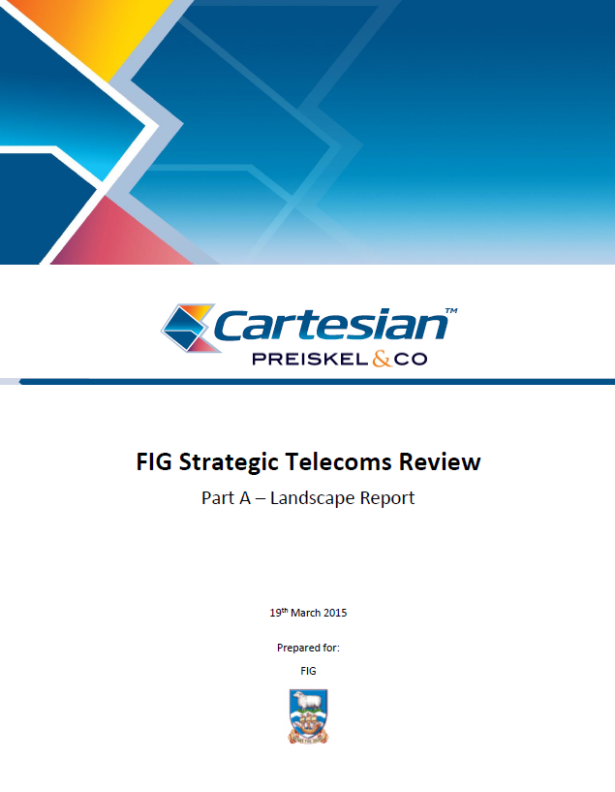
Cartesian identified six key priority issues…
Increased broadband monthly allowances
‘Fair’ retail pricing and toothier price cap regime
Increased access speeds and service
Wider mobile coverage
Increased international capacity
Replacement of end-of-life and obsolescent equipment
Immediate and sustained investment needed to deliver these objectives

Slide 6
…which resonate with the findings from the public consultation
Substantial increases in broadband data allowances
  Increasingly, broadband is an essential utility
  2014 data packages very limited and falling behind rest of world
Expanding mobile network and introducing mobile data
  Much of Camp not covered by mobile network
  Recognition that existing mobile network needed replacing as obsolescent
Reducing overage and ‘billshock’
  Over-package data use prevalent and punitive in terms of cost (up to £100/GB)
  Consumers often faced very large overage bills or cease Internet use
  Needed to enable choice for consumers and in-month data top-ups

Slide 7

Cartesian evaluated five strategic options…
Serve notice on Sure and initiate competitive process for new exclusive licence
Unbundle provision of telecoms services and introduce some element of competition
Structural separation of wholesale (international satellite connection) and retail (service to consumers on the Islands)
Nationalise the telecoms service
Negotiate directly with Sure for new exclusive licence with defined priorities

Slide 8
…and recommended negotiation with Sure
FIG economic analysis aligned with recommendation from consultants
Very small market for telecoms on the Falklands
Geographically spread population
Policy principle for Universal Service Obligation
Option preserved to compete exclusive licence or unbundle if negotiated agreement with Sure could not be reached

Slide 9
New price control regime to protect consumers and ensure investment
In recent years, Sure’s operations in the Falklands have lower rates of capital intensity and higher rates of return than other benchmarked companies
In FIG’s assessment (based on external advice) this is likely due to three factors:
  Lack of investment from C&W then Sure nearing end of licence
  Insufficiently robust price cap in previous regime
  ‘Windfall’ revenues for Sure from oil rounds
Under the new licence there would be a new price cap with a focus on necessary investment and on substantial broadband increases
The formula for this was based on a set of assumptions in terms of costs, revenues, investment and acceptable rate of return
The price control mechanism is designed to protect consumers from ‘monopoly excess’ while incentivising Sure to be efficient and innovative

Slide 10
A number of interactions were held with Sure between May and November 15
Date | Activity
May 15 | Sure invited to submit initial proposal
Jun 15 | Discussions with Sure/Batelco
Jun 15 | FIG and Sure meet satellite providers to discuss options
Aug 15 | Sure requested to improve proposal substantially
Sep/Oct 15 | Improved proposals from Sure with more concrete proposal
Nov 15 | Negotiations with Sure/Batelco to improve offer further
Nov 15 | Best and final offer
Dec 15 | ExCo approved key points of offer in principle subject to licence
Cartesian provided technical advice and due diligence at key points to help validate viability and cost implications of proposals

Slide 11
The detail of the draft licence has recently been completed
Licence drafted by external experts and contains a number of areas:
  Service improvements and obligations on Sure
  Licence term and notice period
  New Price Cap arrangements
  Key Performance Indicators
  Requirements on transparency
  Change in control limitations
  Exit provisions

Slide 12
There will be substantial increases in broadband allowances
Package | Starter | Lite | Bronze | Silver | Gold | Platinum
Monthly Price | £15* | £37* | £75* | £180 | £300 | £425
Data Quota 2015 (GB) | 0.70 | 2.00 | 5.15 | 10.50 | 18.75 | 31.25
Jan 2016 Data Quota (GB) | 1.5 | 4.5 | 9 | 22.5 | 37.5 | 52.5
Jan 2017 Data Quota (GB) | 2 | 6 | 12 | 30 | 50 | 70
Jan 2019 Data Quota (GB) | 3 | 9 | 18 | 45 | 75 | 105
Those packages marked * also had a small price reduction

Slide 13
Changes to address overage and billshock
First, reduction in overage charges already introduced to cap charges at £70/GB for smaller packages (down from £100/GB)
Second, the introduction of a web portal in 2017 to prevent overage charges without explicit consent of consumer – through an ‘opt in’ web portal
Third, and most useful, the introduction in 2017 of data top-ups within a month to allow consumers to purchase extra data at £15/GB

Slide 14
Replacement and expansion of mobile network
The legacy mobile network will be replaced with a modern 4G network which will enable mobile data in Stanley, MPC, Goose Green, Port Howard and Fox Bay
New infrastructure will be installed for 2G mobile (voice) to deliver the following benefits:
  Improve coverage in the north Camp (roads and communities)
  Extend coverage to Hill Cove and other communities on the northern coast of West Falkland, Saunders, Carcass and Pebble Islands (including roads)
  Provide coverage to the North Arm settlement
  Improved coverage around Stanley, MPC, Fitzroy and MPA-Stanley road

Slide 15

Questions on commercial process, priorities or licence?

Slide 16
New Communications Bill*
* This is subject to Legislative/ Select Committee process
Regulation of the whole sector – objectives and principles
  Direct communications controlled – e.g. VSAT and Sat Phones
Recognises public assets – numbering, domains, spectrum, network
Technology neutral
  Licences – individual, class, broadcasting stations, and exclusive
  Public assets and Spectrum management
Proactive Regulator
Penalties for non-compliance with licence
Public Control ‘step in’ rights

Slide 17
New Communications Bill (2)
Excluded
  HMG, MOD (operations), FIG, BAS
  Private networks (e.g. on farms), SOS Equipment, Maritime, Aircraft
  Broadcasting and wireless telegraphy licences (by those ordinances)
Consumer standards and Protection
Content regulation
Data Retention and Disclosure
  Court order required
Data interception and Warrants

Slide 18
Towards better regulation
Independent Regulator
Ability to regulate import, and use
Information and monitoring
Penalties
  Key Performance Indicator Compliance
  Customer service Compliance
Telecoms Appeals Panel and Courts
Managed Exit and Handover Arrangements

Slide 19
Future issues and priorities – broadband
The demand for data is increasing fast – in developed Western economies the use of broadband data doubles every 2.5 to 3.5 years
This is not just social use…many software packages and applications are moving to the cloud rather than local servers
The Falklands will see an average fourfold increase in data allowance over the first four years of the licence (2016-2020)
The licence requires a critical review of future data requirements in early 2019 to inform discussions between the Regulator, FIG and Sure about international capacity beyond 2020

Slide 20
Future issues and priorities – mobile data
In the UK and other large economies, mobile data has transformed the mode of connectivity and changed both social and business use of the Internet
It is difficult to predict how the advent of mobile data will change the way that Falkland Islanders (and visitors) will interact with the Internet…but it is safe to say that there will be changes
This will also likely be a topic for review in early 2019

Slide 21
Future issues and priorities – the unknowns
There are known knowns.
These are things we know that we know.
There are know unknowns.
That is to say, there are things we know we don’t know.
But there are also unknown unknowns.
These are things we don’t know we don’t know.
From the Poetry of Donald Rumsfeld, former US Secretary of Defense
In an age when smart fridges can launch cyber-attacks it is difficult to predict where telecoms will be in five years’ time
There will be challenges, risks and opportunities for the Falklands
It is important that FIG (and Sure) are proactive and alert to emerging technologies and social trends

